Slide 1

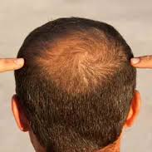
SEPTEMBER 2023
Empowering Hair Health With Intelligent Hair Disease Detection Systems
2023 - 154
Presented by Olivia Wilson

Slide 2
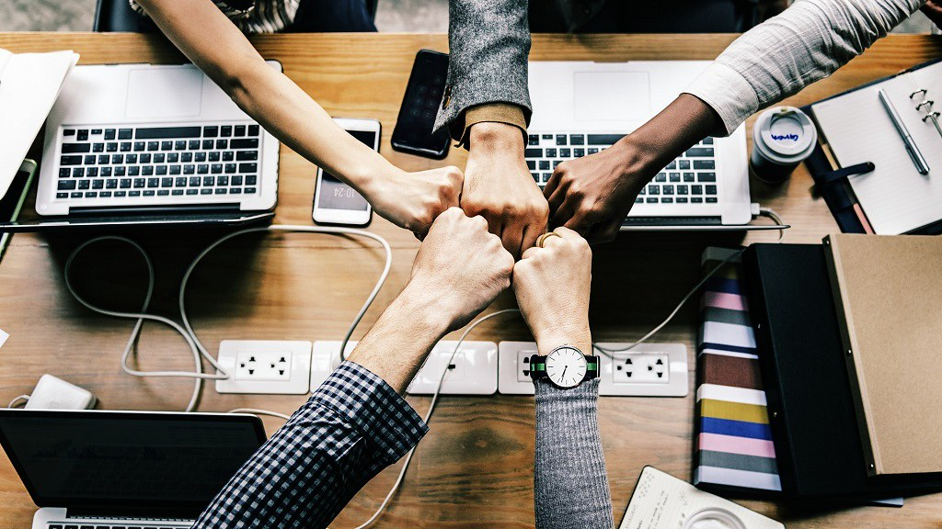
Supervisor – Ms. Lokesha Weerasinghe
Co-Supervisor – Ms. Thamali Dassanayake
External – Supervisor - Dr. Mallika Hewawitharana
Group Details
STUDENT NAME | STUDENT ID
Wickramarathma D.G.N.L | IT20154158
Nanayakkara V.G | IT20159580
Bandaranayake V.R.W | IT20232290
Alahakoon D.Y.R | IT20129026

Slide 3
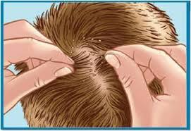
INTRODUCTION
We propose this application detect to hair disease.
Recommend to the treatment.
Predict to the symptoms and side effects.
Scanning prescriptions schedule meetings and showing reminders.
Use 5 Hair Diseases for that project.
Head Lice
Alopecia Areata
Telogen Effluvium
Tinea Capitis
Folliculitis

Slide 4
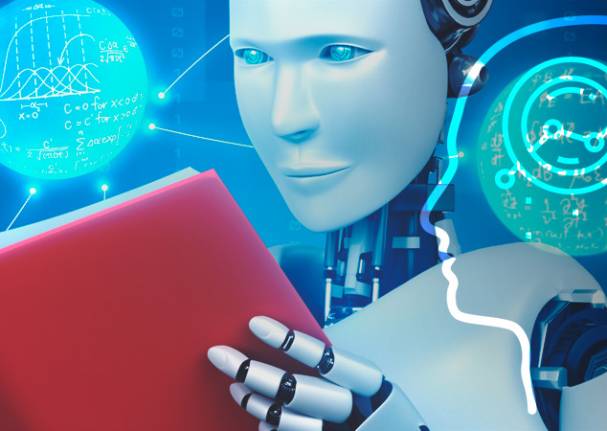
RESEARCH PROBLEM
High cost of full hair diseases analysis.
Lack of awareness of hair diseases information
Inability to identify what hair disease is due to the inherent characteristics of different hair diseases.
Not being able to identify the necessary treatment in a way that does not damage the hair.

Slide 5

MAIN OBJECTIVES
The main objective of "Empowering Hair Health with Intelligent Hair Disease Management Systems" research is to identify, understand, and develop effective treatments for various hair and scalp disorders that affect human beings. All are doing in mobile application through.

Slide 6
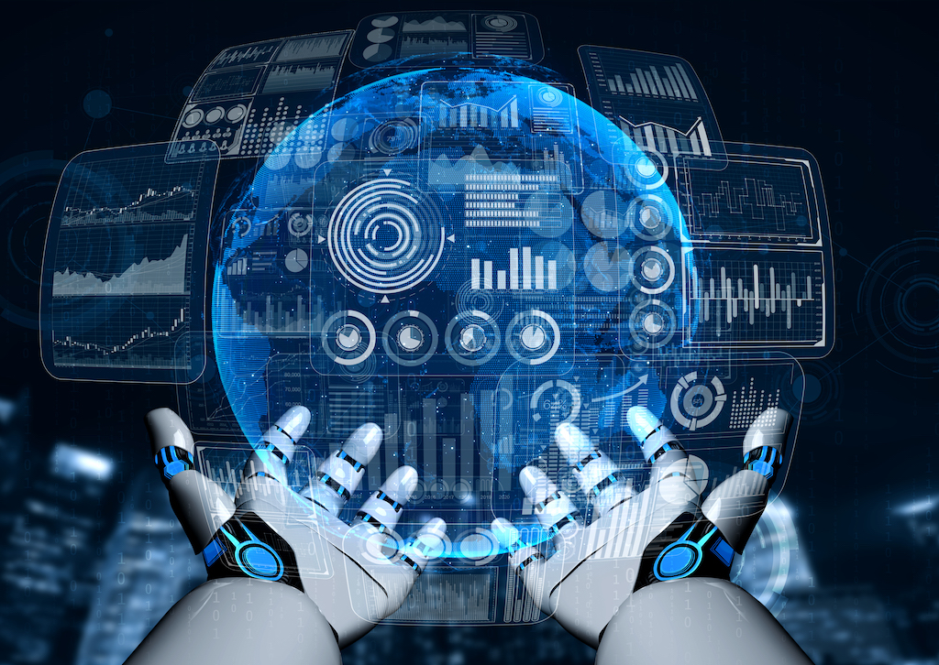
SUB OBJECTIVES
Extracting patient prescription data using easyOCR and setting reminders using those data.
Hair Disease Treatment Recommendations for using Machine Learning-based Model.
Predicting symptoms and side effects using hair disease.
Automatic hair scratch and hair losing detection using IOT device with machine learning.

Slide 7
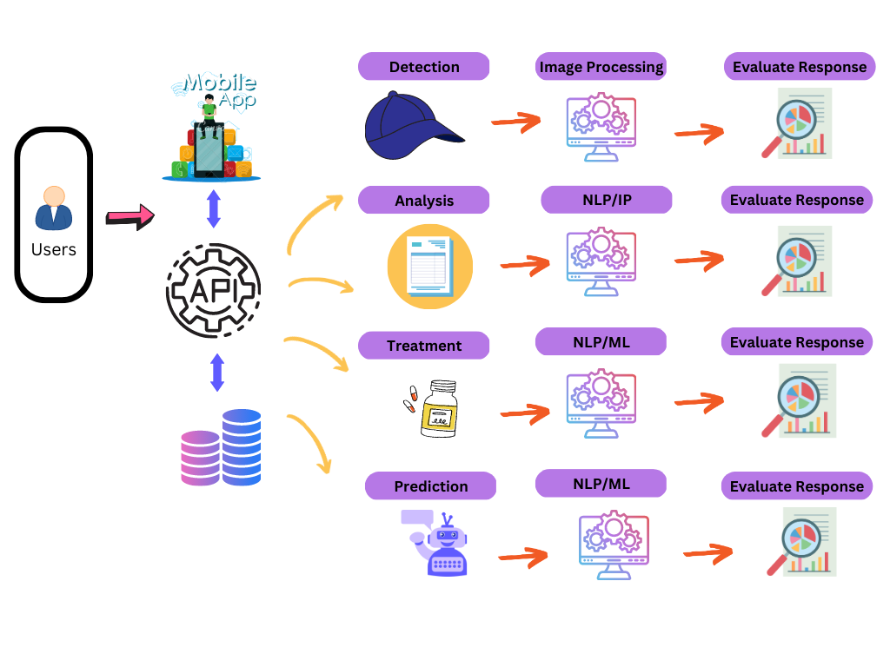
SYSTEM DIAGRAM

Slide 8
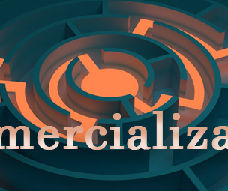
COMMERCIALIZATION ASPECTS
Why Should buyers use HairDiary?
Why Should sellers use HairDiary?

Slide 9
WHY SHOULD BUYERS USE HAIRDIARY
Can get a best knowledge hairdiary diseases and treatments.
Helps to make financial safe decisions
Helps to make decisions based personal preferences
Trustworthy properties, minor chance caught into frauds

Slide 10
WHY SHOULD SELLERS USE HAIRDIARY
Seller journey will be smooth due to extensive seller support system
Can expect larger pool of buyers
Hair diseases treatment will be automatically suggested appropriate buyers

Slide 11
BUDGET
Component | Amount LKR
IOT Device | 30,000 /=
Internet Charges | 3,000 /=
Telephone Charges | 1,000 /=
Cloud DB | 3,000 /=

Slide 12

IT20154158 Wickramarathna D.G.N.L
Specialize in Information Technology
IT20154158 | D.G.N.L.Wickramarathna | 2023-154

Slide 13
Extracting patient prescription data using easyOCR and set reminders using those data
IT20154158 | D.G.N.L.Wickramarathna | 2023-154

Slide 14

BACKGROUND
How to extract patient prescription data.
How to set the reminders for take medicine and next the doctor meeting time according extracted patient prescription.
IT20154158 | D.G.N.L.Wickramarathna | 2023-154

Slide 15
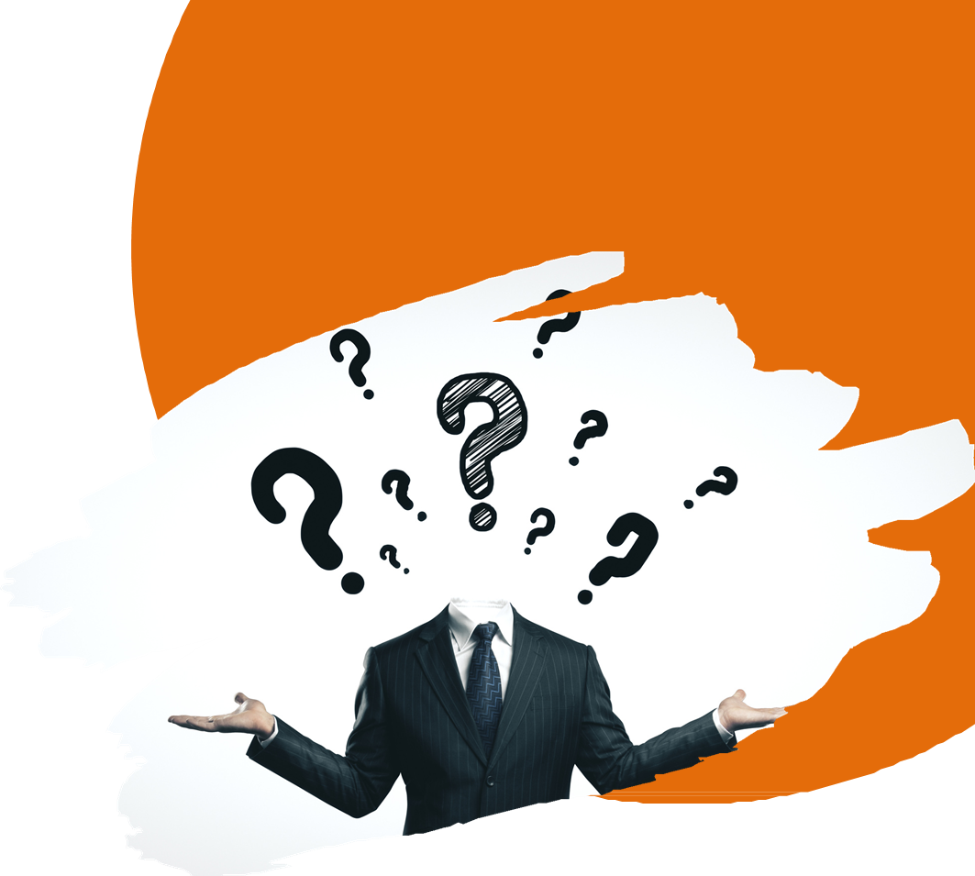

RESEARCH QUESTION
Extraction of Relevant Information in patient prescription
. Accuracy and reliability of extracted data.
IT20154158 | D.G.N.L.Wickramarathna | 2023-154

Slide 16
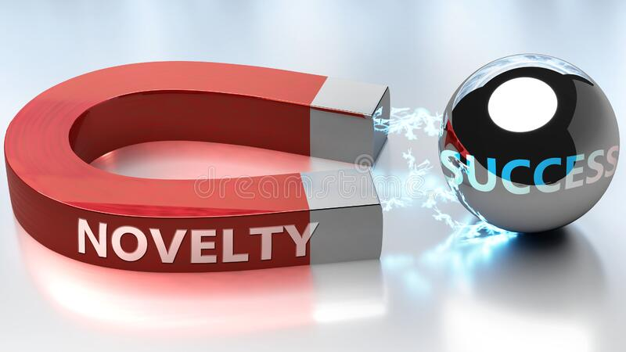
RESEARCH GAP
Exploring Methods for Semantic Understanding of Extracted Prescription Data.
Research methods for personalizing medication and appointment reminders to suit individual patient preferences and needs.
IT20154158 | D.G.N.L.Wickramarathna | 2023-154

Slide 17

MAIN OBJECTIVE
Extract patient prescription data using easyOCR.
Use that information to set reminders.
IT20154158 | D.G.N.L.Wickramarathna | 2023-154

Slide 18

SUB OBJECTIVE
Show the extracted data for gain information.
Edit and set different reminders using those extracted data.
IT20154158 | D.G.N.L.Wickramarathna | 2023-154

Slide 19
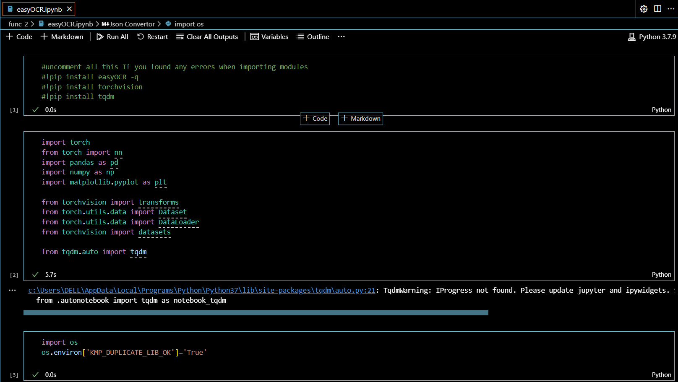
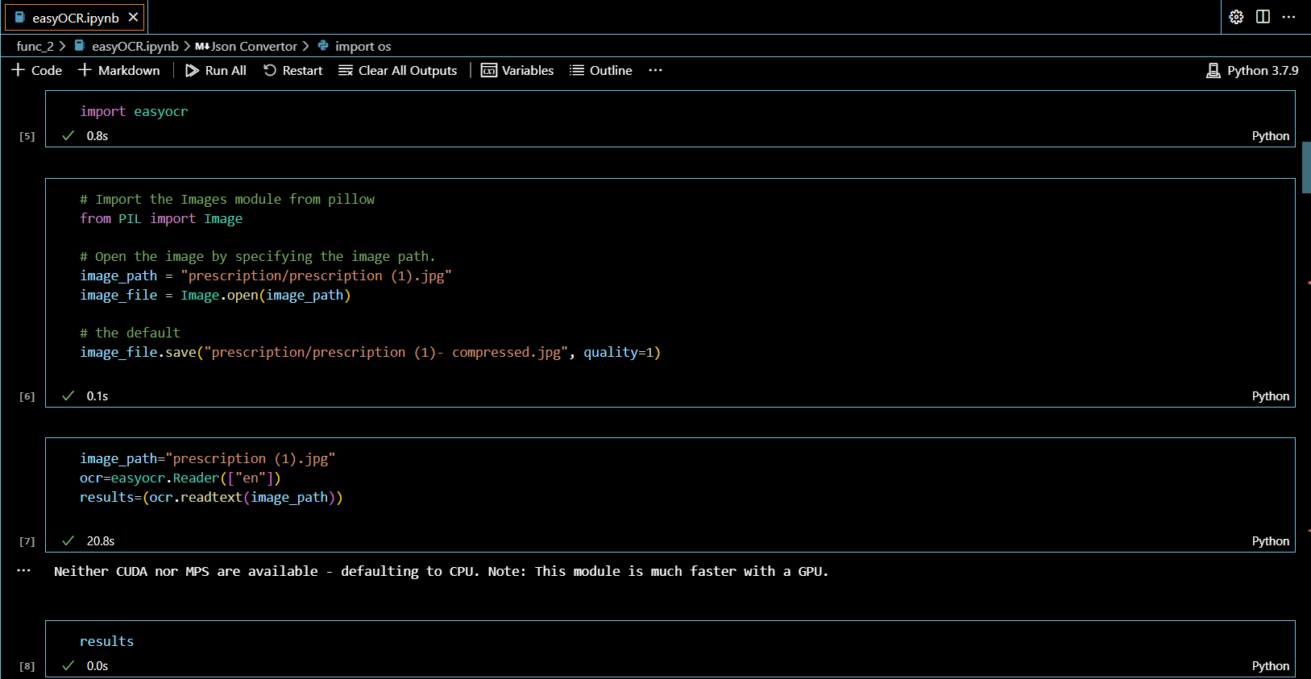
MACHINE LEARNING PART - Completed
Current progress (100%)
IT20154158 | D.G.N.L.Wickramarathna | 2023-154

Slide 20
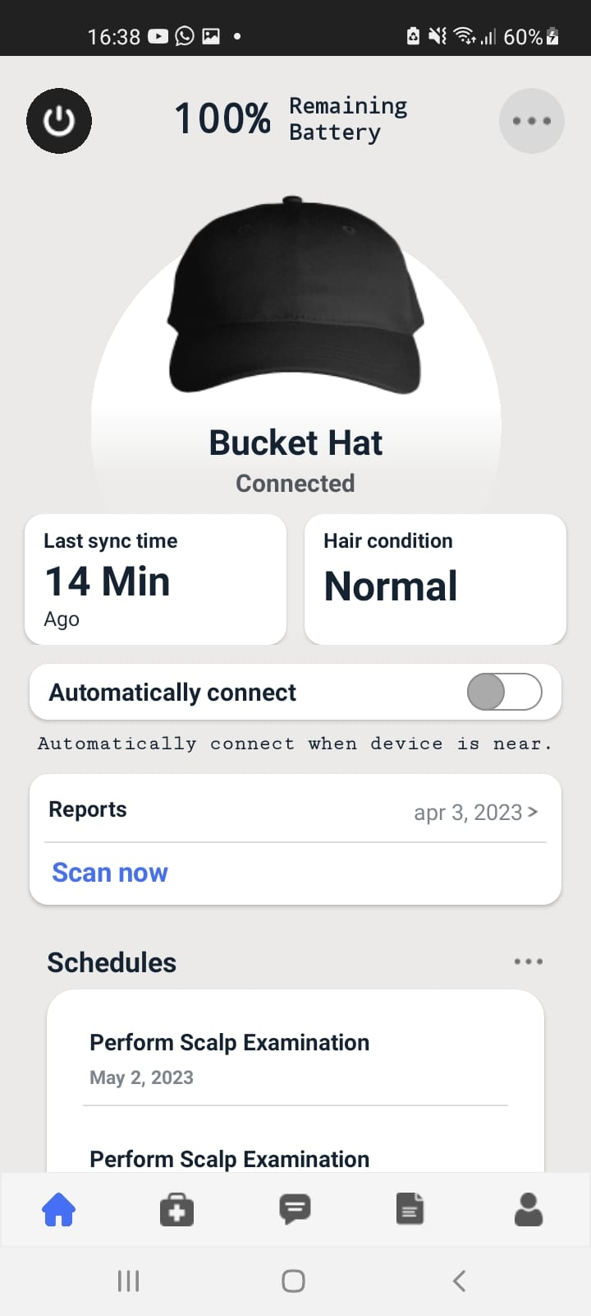
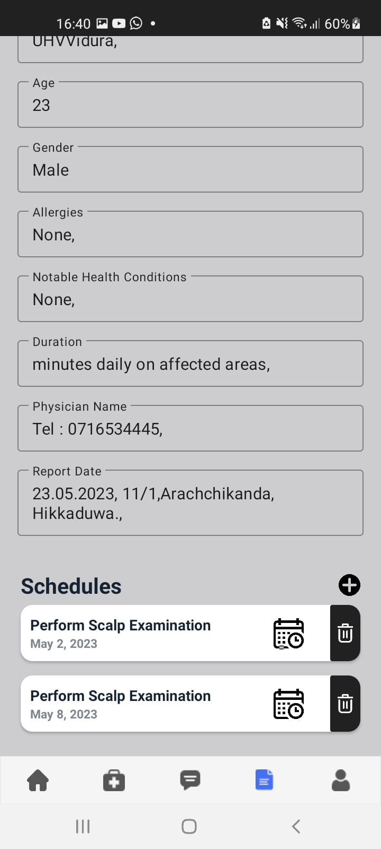
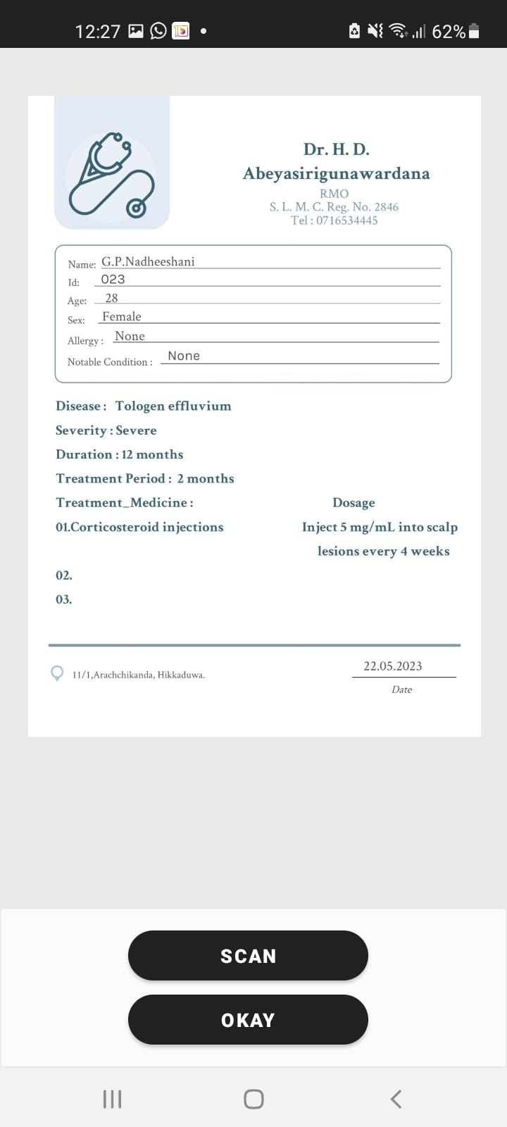
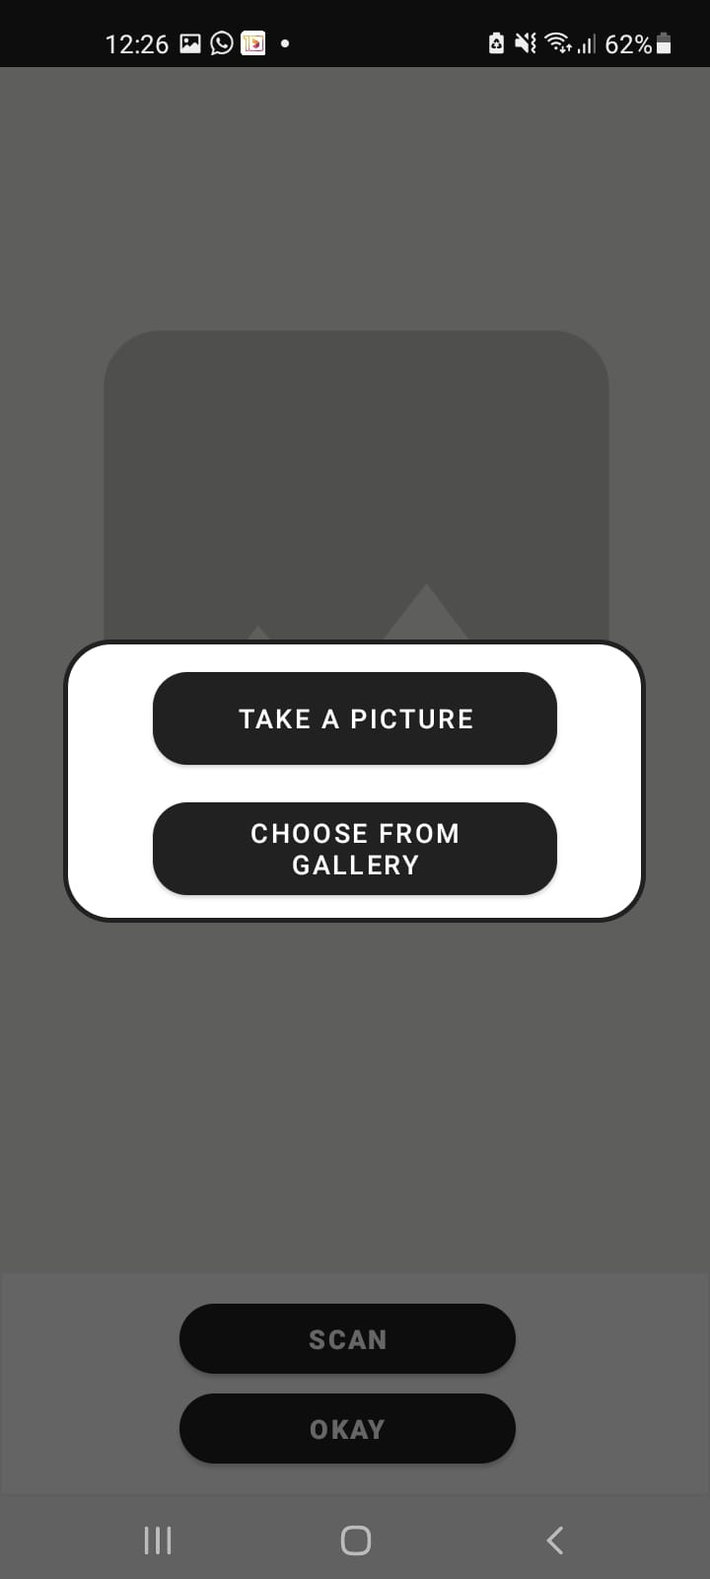
MOBILE APPLICATION FRONT-END DEVELOPMENT
Showing Scan image or Upload image buttons.
Showing Current Time and Date.
Show If Camera is connected or not.
Show prescription data.
Show Next doctors meeting date.
Show reminders are set or not.
§Development – 95% Completed
IT20154158 | D.G.N.L.Wickramarathna | 2023-154

Slide 21
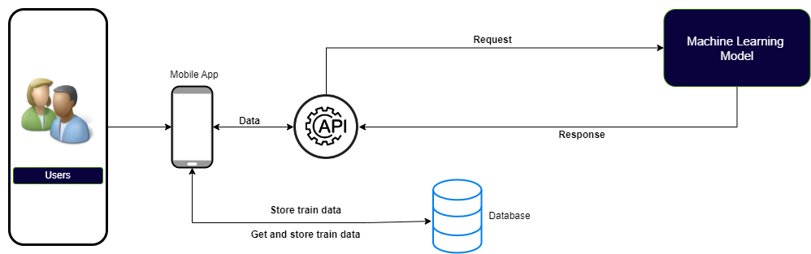
SYSTEM DIAGRAM
IT20154158 | D.G.N.L.Wickramarathna | 2023-154

Slide 22

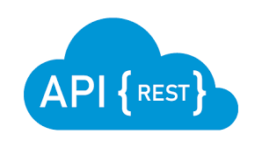




Tools and Technologies
Mobile Application
Android Studio
Database
Firebase
Middle Ware Technologies
Python
Technical Concepts
Machine Learning
Data Set
Meet a Doctor
IT20154158 | D.G.N.L.Wickramarathna | 2023-154

Slide 23
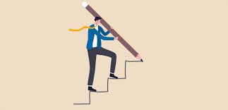
FOLLOWED STEPS
Import relevant libraries
Data collection and processing
Building a system
Front-end development
IT20154158 | D.G.N.L.Wickramarathna | 2023-154

Slide 24

ACHIVMENTS
Collecting Necessary Dataset.
Preparing the necessary environment in the machine.
Successfully developed matching learning part.
Successfully implemented the backend API and connected with the frontend.
Successfully integrated the system.
IT20154158 | D.G.N.L.Wickramarathna | 2023-154

Slide 25
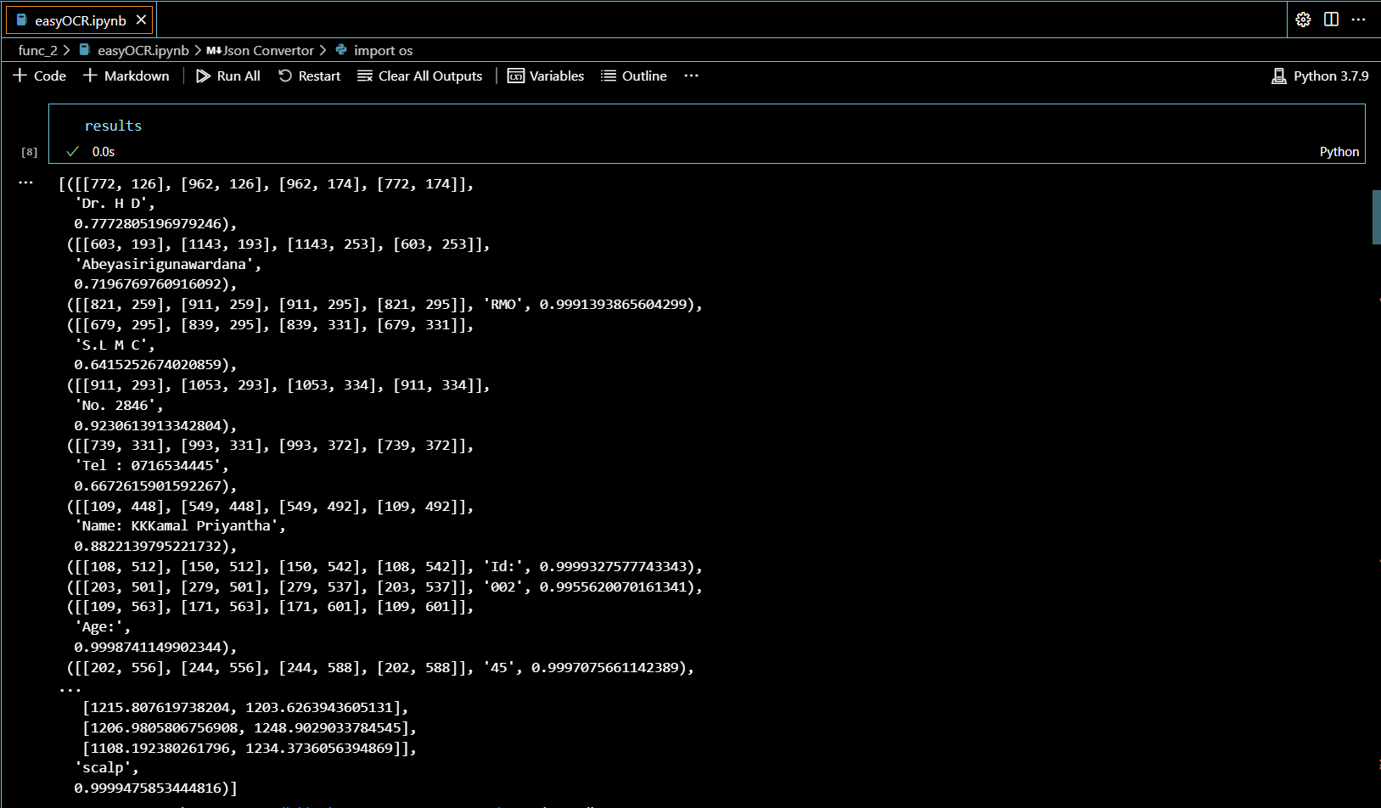
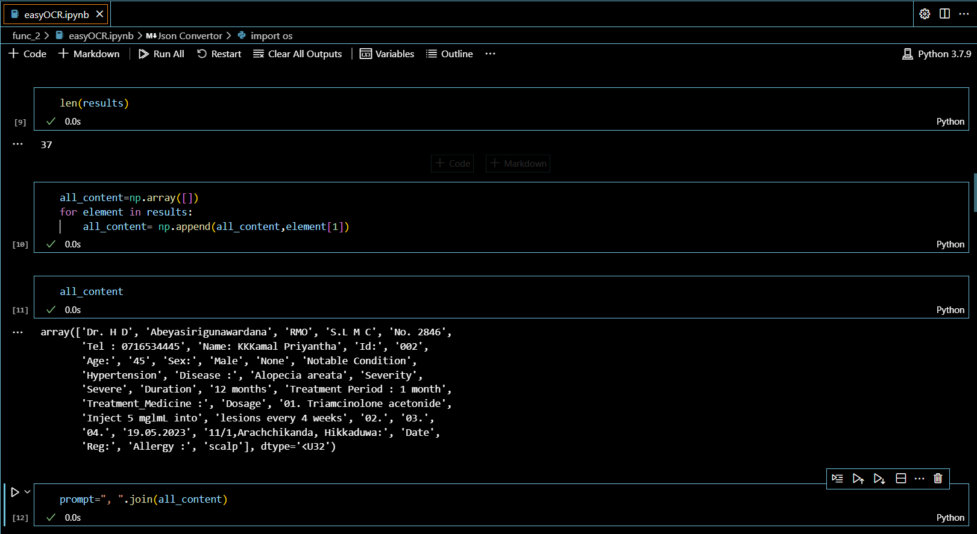
RESULTS AND DISCUSSION
Extract data and analyze data successfully.
IT20154158 | D.G.N.L.Wickramarathna | 2023-154

Slide 26
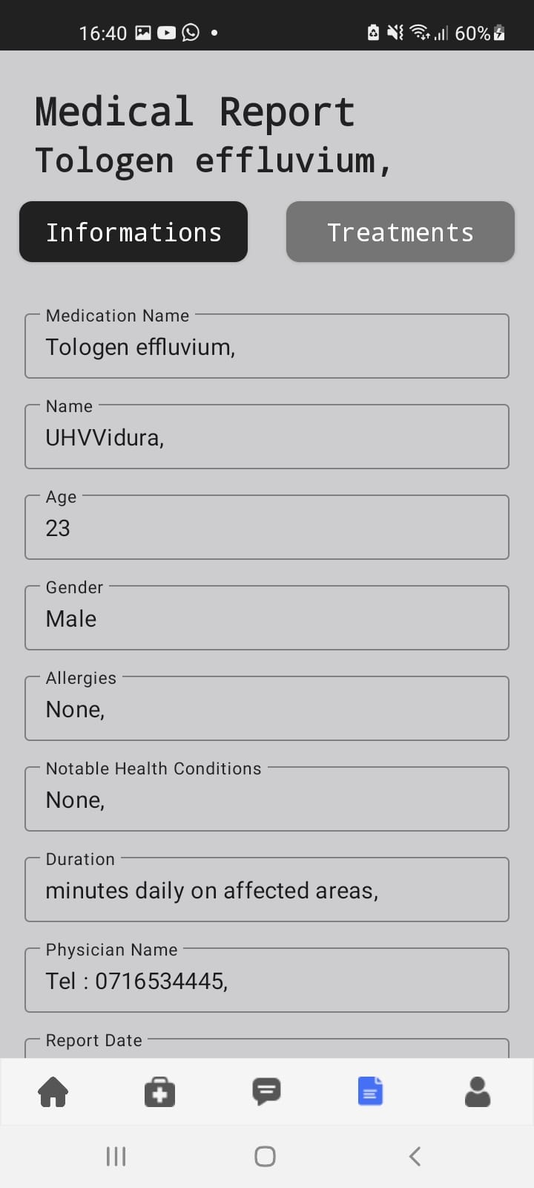
RESULTS AND DISCUSSION
Using extracted data show relevant data and set reminders
in mobile app.
IT20154158 | D.G.N.L.Wickramarathna | 2023-154

Slide 27
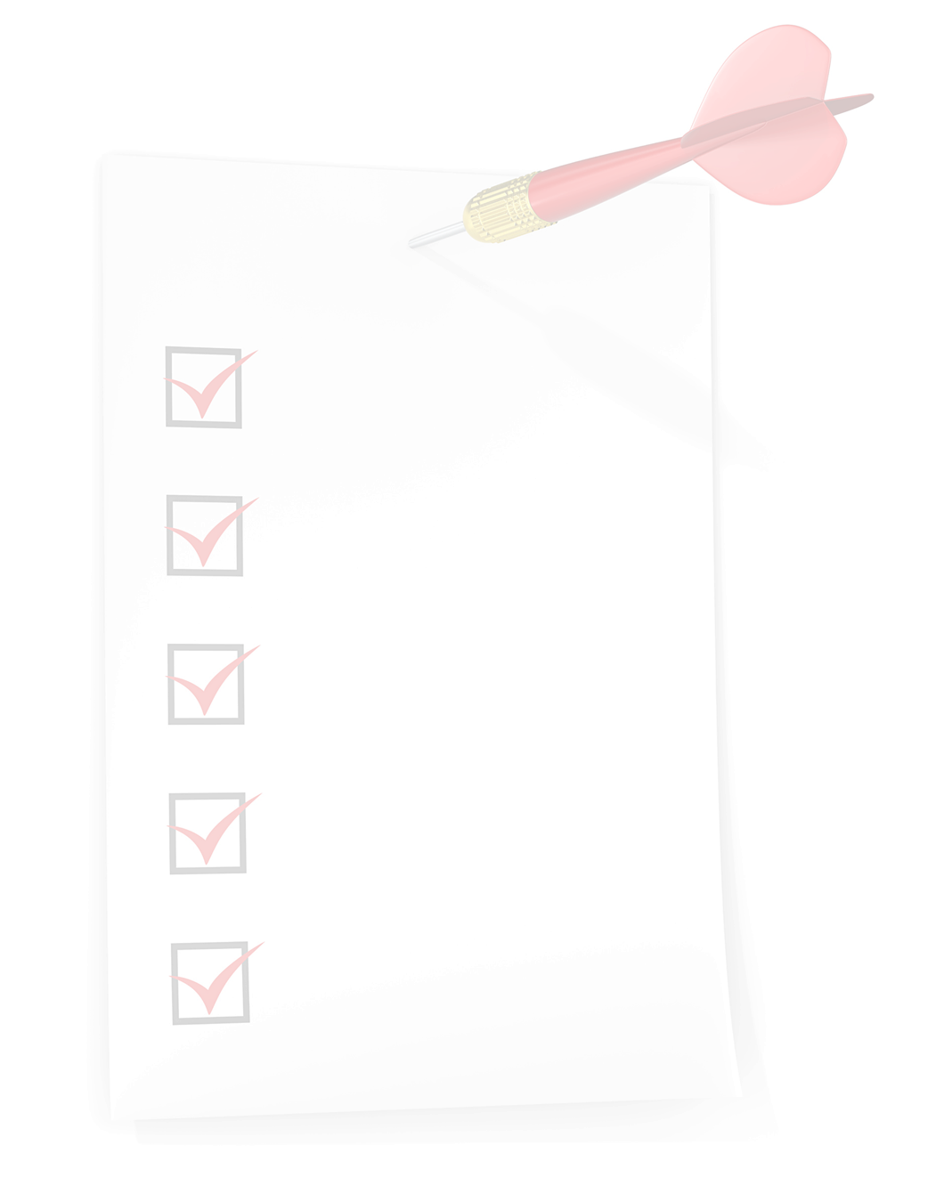
WHAT'S TO BE DONE
Mobile app bugs fixing.
IT20154158 | D.G.N.L.Wickramarathna | 2023-154

Slide 28
References
Xiong, Y., Cai, Y., Li, Y., Li, W., Li, X., Li, Y., & Wu, J. (2021). An intelligent hair loss diagnosis and treatment system based on machine learning and knowledge graph. BMC medical informatics and decision making, 21(1), 1-13.
Chiang, P. C., Wu, T. Y., Huang, P. Y., Wu, M. T., & Hsu, C. Y. (2018). Design and implementation of a smart hair care system. International Journal of Human-Computer Studies, 110, 18-28.
Al-Taee, M. A., & Al-Yasiri, A. (2021). Intelligent health-care system for hair disease detection using machine learning techniques. Applied Soft Computing, 101, 107113.
Lai, W. L., Tsai, Y. F., Huang, C. H., & Chen, W. H. (2018). Smart hair care system using fuzzy logic and neural network technologies. Applied Soft Computing, 70, 298-309.
IT20154158 | D.G.N.L.Wickramarathna | 2023-154

Slide 29

IT20159580 NANAYAKKARA V.G
Specialize in Information Technology
IT20159580 | Nanayakkara V.G | TMP-23-154

Slide 30
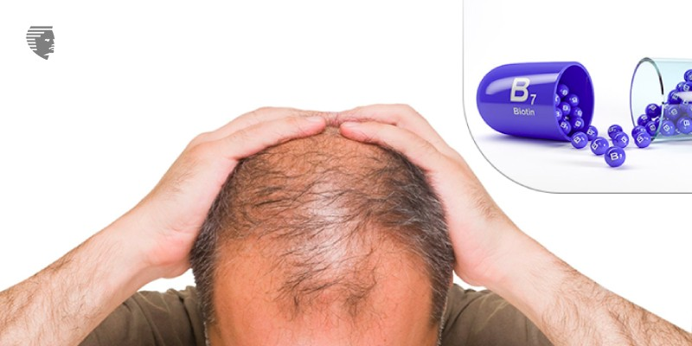
Hair Disease Treatment and Medicine Recommendations using Machine Learning-based Model
IT20159580 | Nanayakkara V.G | TMP-23-154

Slide 31
Background
Hair Diseases Treatment Recommendation Using ML Model.
Analyze Patient Data using Recommendation Model.
Treatment Management.
IT20159580 | Nanayakkara V.G | TMP-23-154

Slide 32
Research Question
How to recommend hair disease treatment via
a mobile ?
What is the accuracy of ML Model ?
IT20159580 | Nanayakkara V.G | TMP-23-154

Slide 33
RESEARCH GAP
Allergies have not been considered in other systems before the recommended medicine.
IT20159580 | Nanayakkara V.G | TMP-23-154

Slide 34
Main Objective
Develop a machine learning-based model that can provide accurate medical recommendations for head rashes, while considering patient preferences, to improve treatment options and empower patients to manage their own health.
IT20159580 | Nanayakkara V.G | TMP-23-154

Slide 35
Sub Objective
Develop a machine learning-based model for reliable and accurate hair disease treatment recommendations.
Collect and analyze data effectively to train the machine learning algorithms.
Consider patient preferences in the recommendations provided.
IT20159580 | Nanayakkara V.G | TMP-23-154

Slide 36
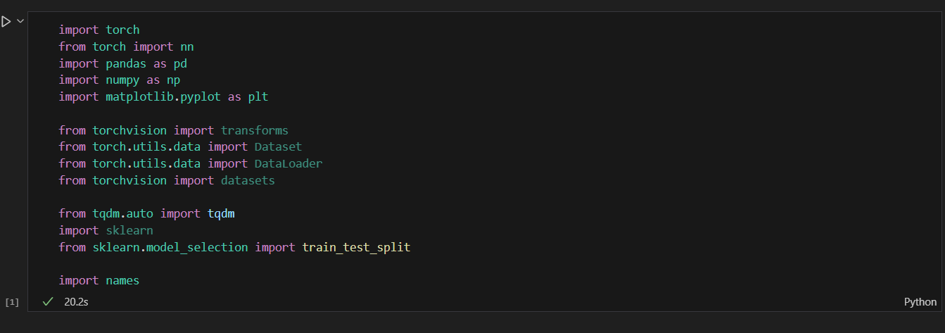
Current progress (90%) •Analyze Dataset & Preprocessing -Completed
§import packages and install torch

Slide 37
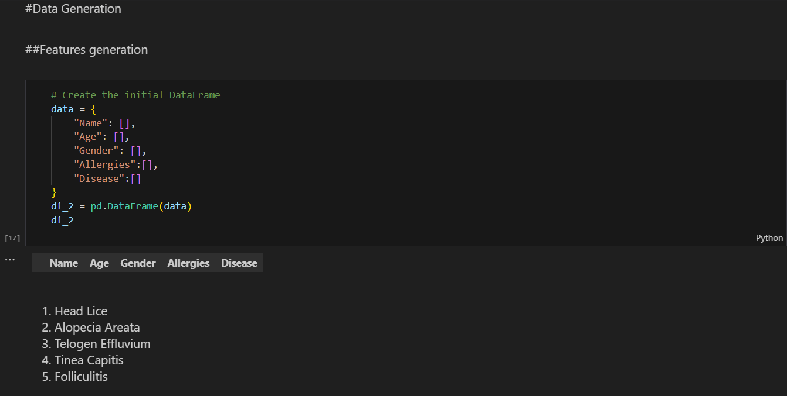
Current progress (90%) •Data Generation & Features Generation -Completed

Slide 38
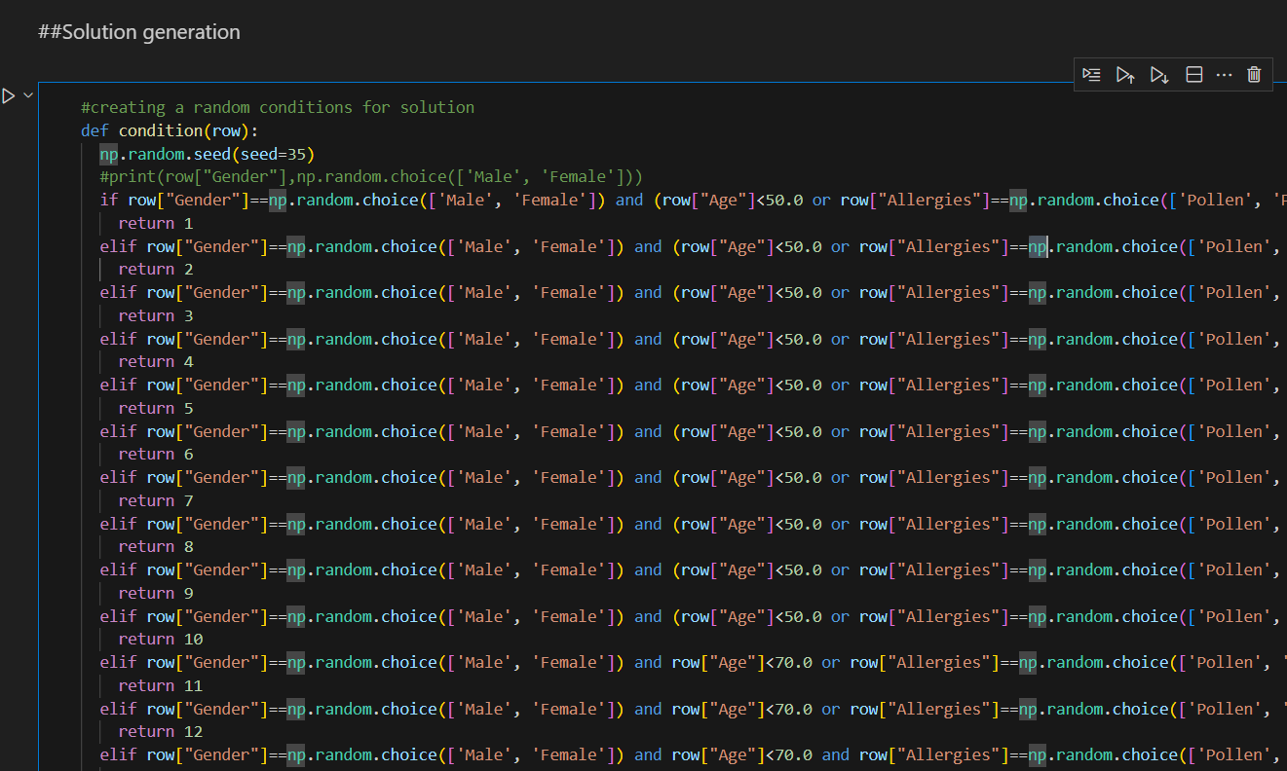
Current progress (90%) •Solution Generation -Completed

Slide 39
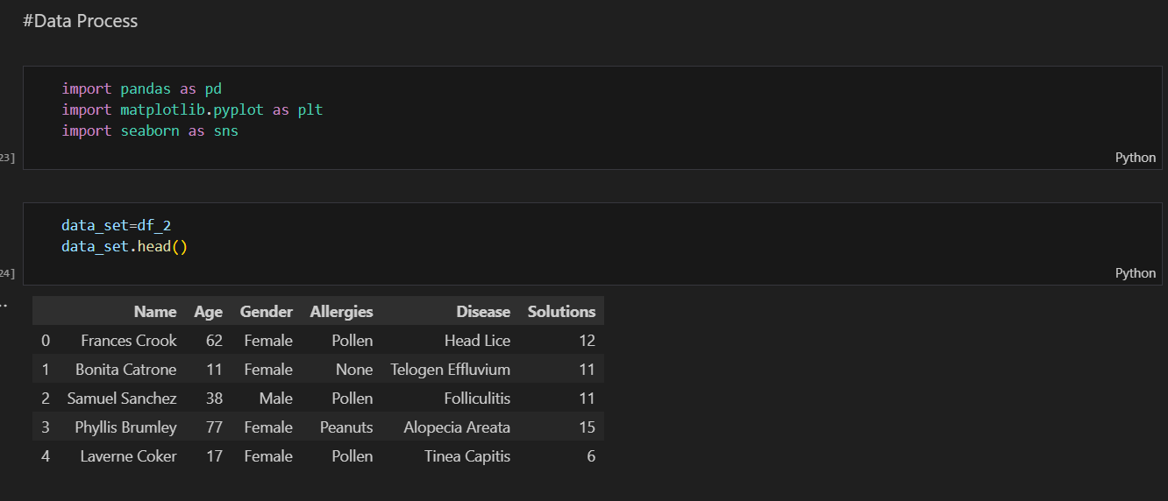
Current progress (90%) •Data process -Completed

Slide 40
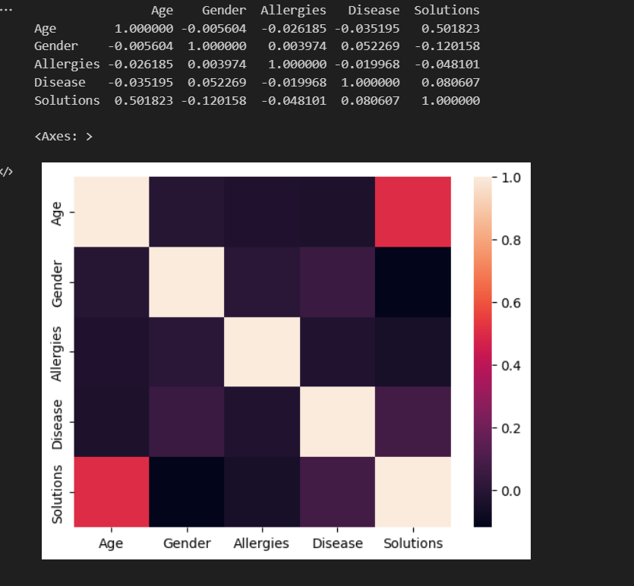
Current progress (90%) •Data Visualizing -Completed

Slide 41
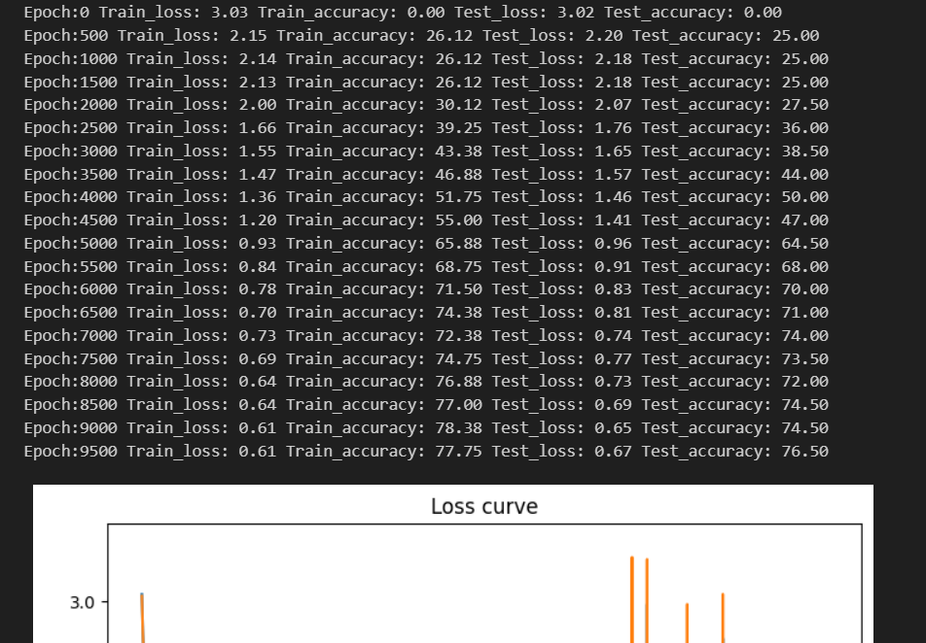
Current progress (90%) •Model Test Accuracy

Slide 42
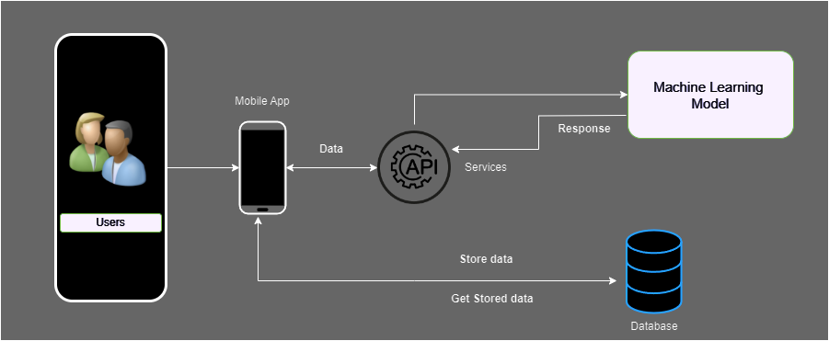
System Diagram
IT20159580 | Nanayakkara V.G | TMP-23-154

Slide 43
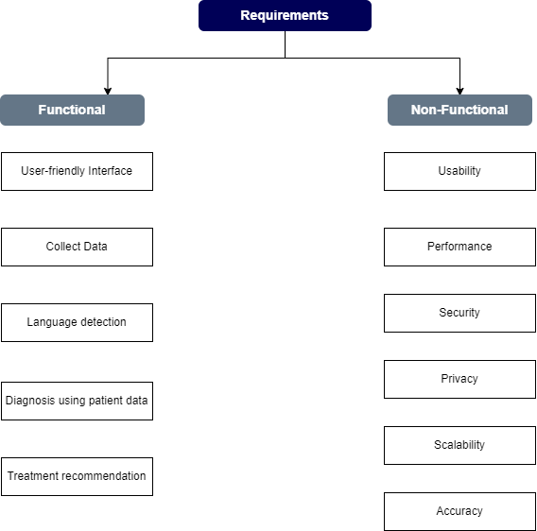
Requirements
Functional and Non-Functional Requirements
IT20159580 | Nanayakkara V.G | TMP-23-154

Slide 44



Tools and Technologies
Mobile Application & Tools
Android
Vs Code & Android Studio
Database
Firebase
Dependencies
Pandas
numpy
matplotlib
Technical Concepts
Pytourch(Deep Learning Framework)
Machine Learning
Algorithum – Linear Regression
IT20159580 | Nanayakkara V.G | TMP-23-154

Slide 45
FOLLOWED STEPS
Import relevant libraries
Data collection and processing
Building a system
Front-end development
IT20159580 | Nanayakkara V.G | TMP-23-154

Slide 46
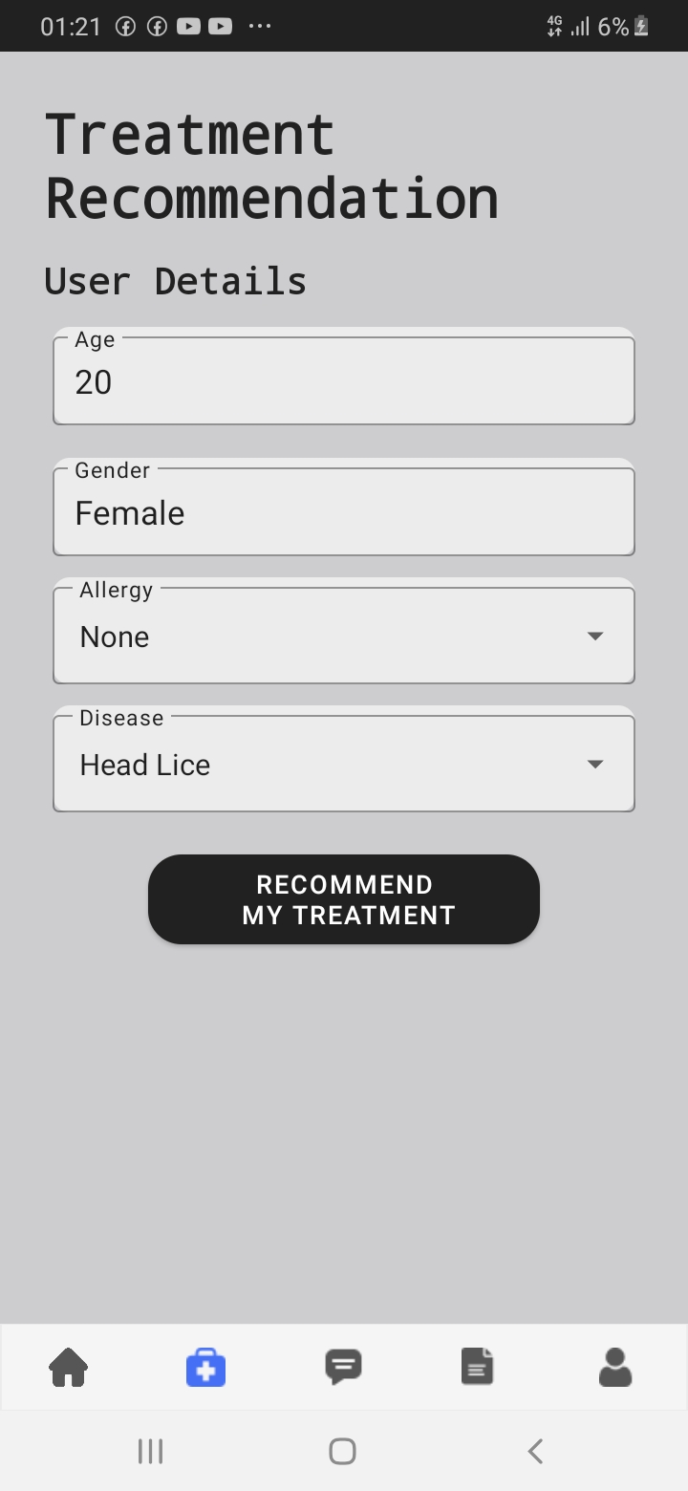
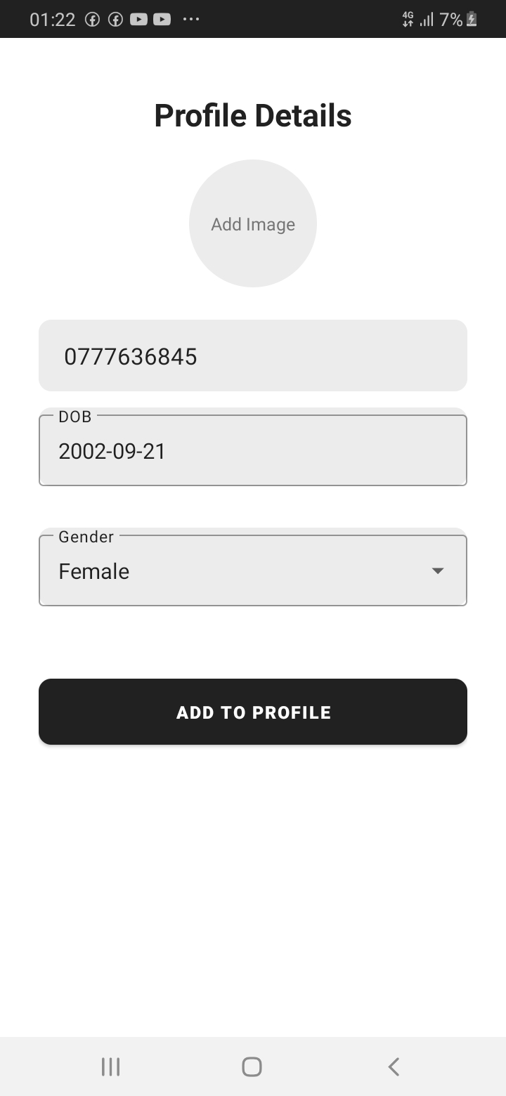
WIREFRAMES
Showing Treatment Recommendation Page.
Showing User Profile.
Users default data get as user details in
Recommendation form
§Development – 90% Completed
IT20159580 | Nanayakkara V.G | TMP-23-154

Slide 47
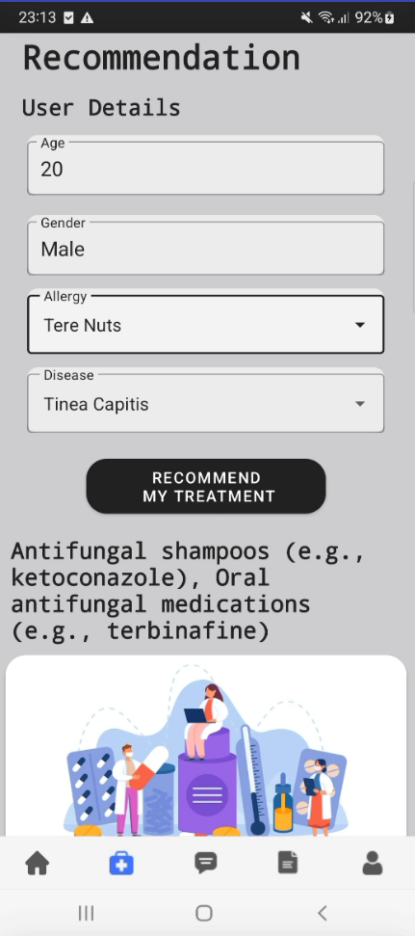
RESULTS AND DISCUSSION
After click Recommend My Treatment button, display treatments like this.

Slide 48
ACHIEVEMENTS
Collecting Necessary Dataset
Preparing the necessary environment in the machine
Drawing Necessary Wireframes
Train Model
Create frontend
IT20159580 | Nanayakkara V.G | TMP-23-154

Slide 49
WHAT'S TO BE DONE
Fix to the Bugs
IT20159580 | Nanayakkara V.G | TMP-23-154

Slide 50
REFERENCES
Rawat, S., Chauhan, A., & Agrawal, S. (2019). Prediction of hair diseases using machine learning algorithms. In 2019 3rd International Conference on Inventive Systems and Control (ICISC) (pp. 932-935). IEEE.
Patel, A., Dave, A., & Joshi, M. (2018). Hair disease identification and prediction system using decision tree classifier. International Journal of Advanced Research in Computer Science, 9(1), 34-37.
Patwardhan, N., & Joshi, M. (2017). Detection of hair diseases using image processing techniques. International Journal of Computer Applications, 168(3), 9-13.

Slide 51

IT20232290 BANDARANAYAKE V.R.W
Specialize in Information Technology
IT20232290 | Bandaranayake V.R.W | TMP-23-154

Slide 52
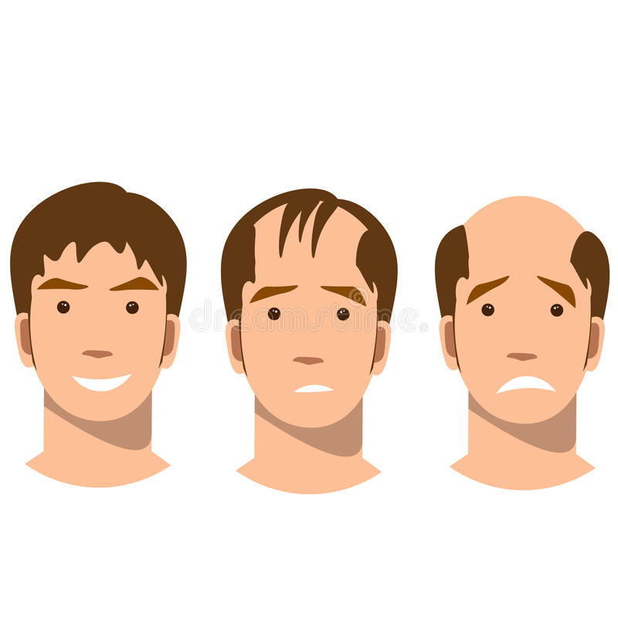
PREDICTING SYMPTOMS AND SIDE EFFECTS USING HAIR DISEASE.
IT20232290 | Bandaranayake V.R.W | TMP-23-154

Slide 53
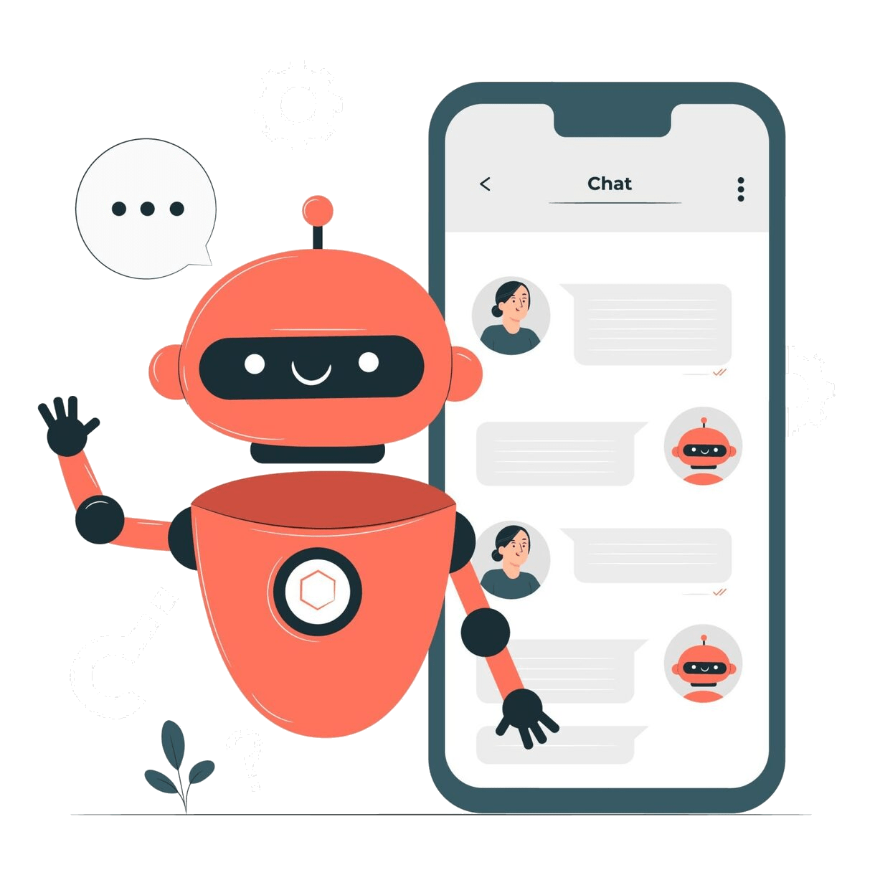
BACKGROUND
Hair diseases symptom prediction Using chatbot.
Shows the side effects.
IT20232290 | Bandaranayake V.R.W | TMP-23-154

Slide 54
RESEARCH QUESTION
How machine-learning-based mobile systems
take place the prediction of hair diseases
using symptoms?
Find Most Suitable Dataset?
IT20232290 | Bandaranayake V.R.W | TMP-23-154

Slide 55
RESEARCH GAP
Predicting disease symptoms by a chatbot.
IT20232290 | Bandaranayake V.R.W | TMP-23-154

Slide 56
MAIN OBJECTIVE
Can diagnose the disease using the symptoms and know what side effects of the disease you have.
IT20232290 | Bandaranayake V.R.W | TMP-23-154

Slide 57
SUB OBJECTIVE
Build various ML model to predict to hair diseases
symptom.
Collect disease symptom data.
IT20232290 | Bandaranayake V.R.W | TMP-23-154

Slide 58
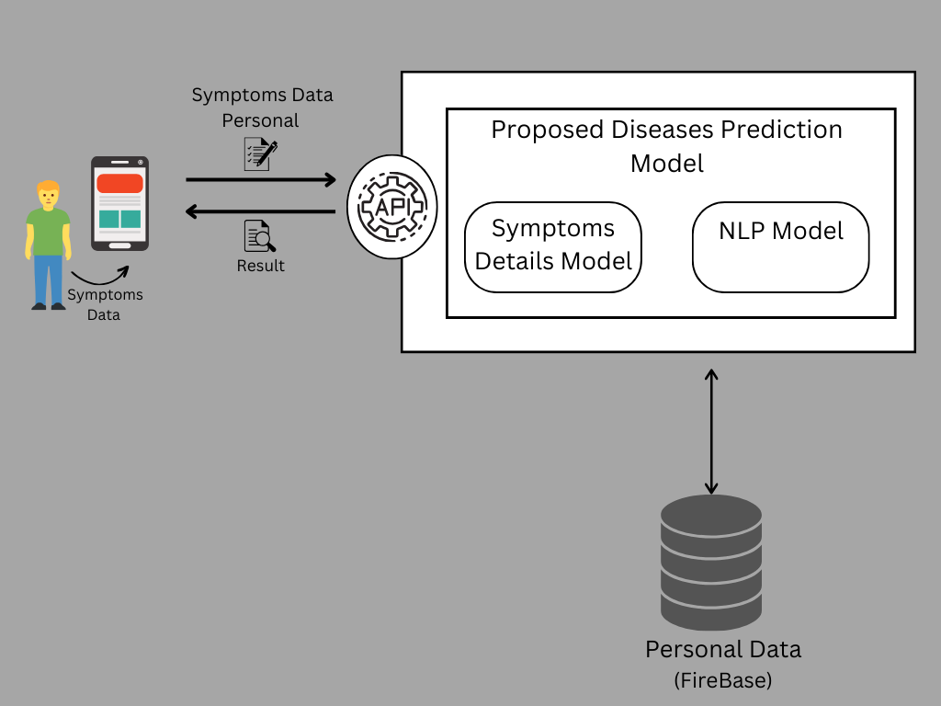
SYSTEM DIAGRAM
IT20232290 | Bandaranayake V.R.W | TMP-23-154

Slide 59
TOOLS AND TECHNOLOGIES
Mobile Application
Android Studio
Database
Firebase
Middle Ware Technologies
Python
Tensorflow
Rest API
Technical Concepts
OpenAI/ LLM
IT20232290 | Bandaranayake V.R.W | TMP-23-154

Slide 60
FOLLOWED STEPS
Import relevant libraries
Data collection and processing
Model training
Building a system
IT20232290 | Bandaranayake V.R.W | TMP-23-154

Slide 61
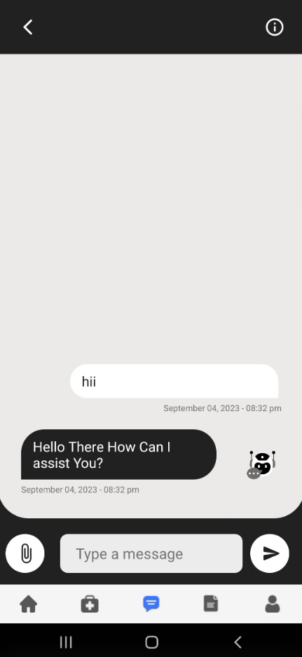
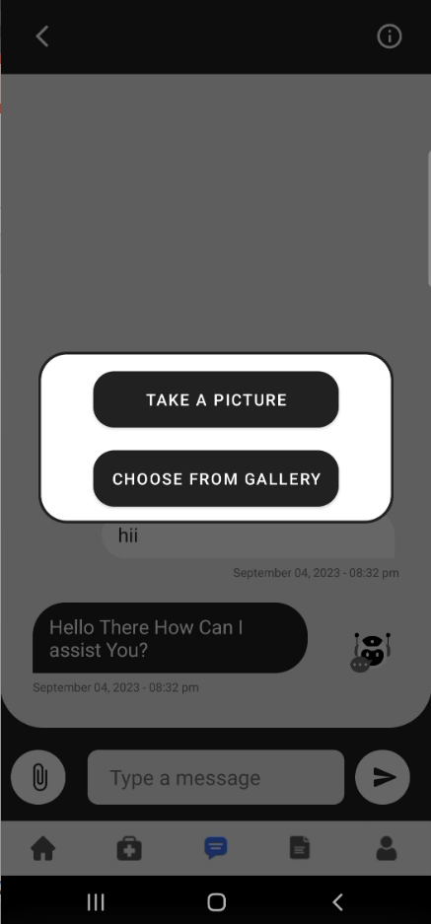
WIREFRAMES
IT20232290 | Bandaranayake V.R.W | TMP-23-154

Slide 62
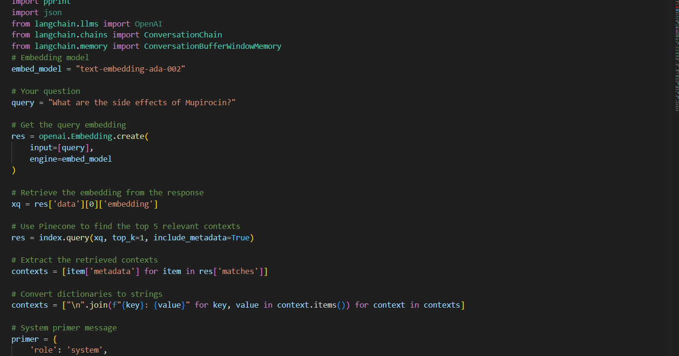
MODEL
IT20232290 | Bandaranayake V.R.W | TMP-23-154

Slide 63
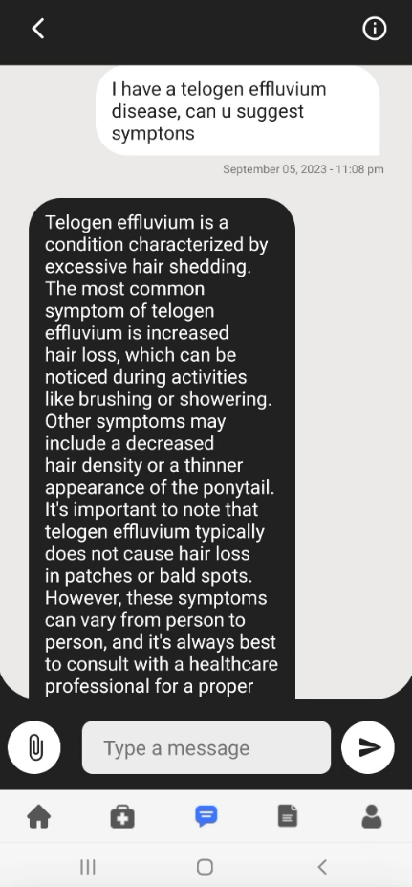
RESULTS AND DISCUSSION
The extracted data is displayed in the mobile application through a chatbot.

Slide 64
ACHIEVEMENTS
Collecting Necessary Dataset
Preparing the necessary environment in the machine
Drawing Necessary Wireframes
Train Model
Create frontend
IT20232290 | Bandaranayake V.R.W | TMP-23-154

Slide 65
WHAT'S TO BE DONE
Fix to the Bugs
IT20232290 | Bandaranayake V.R.W | TMP-23-154

Slide 66
REFERENCES
Rawat, S., Chauhan, A., & Agrawal, S. (2019). Prediction of hair diseases using machine learning algorithms. In 2019 3rd International Conference on Inventive Systems and Control (ICISC) (pp. 932-935). IEEE.
Patel, A., Dave, A., & Joshi, M. (2018). Hair disease identification and prediction system using decision tree classifier. International Journal of Advanced Research in Computer Science, 9(1), 34-37.
Patwardhan, N., & Joshi, M. (2017). Detection of hair diseases using image processing techniques. International Journal of Computer Applications, 168(3), 9-13.

Slide 67
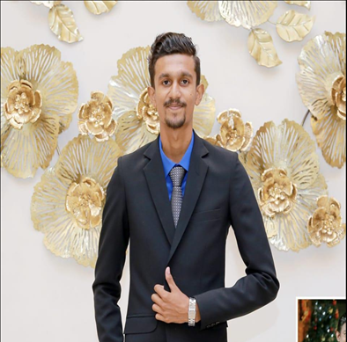
IT20129026 Alahakoon D.Y.R
Specialize in Information Technology
IT20129026 | Alahakoon D.Y.R | TMP-23-154

Slide 68
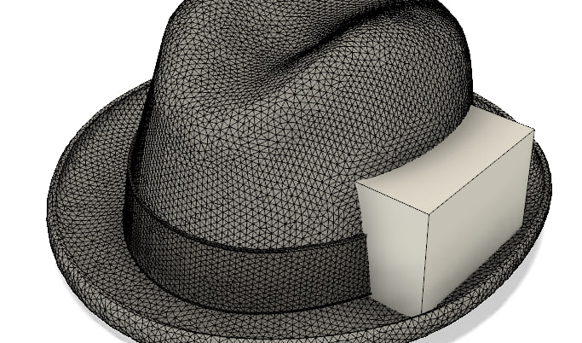
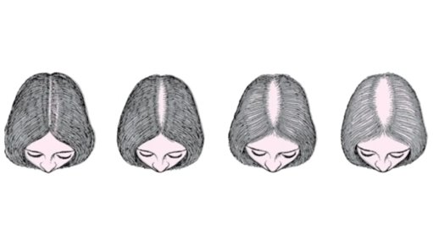
Smart Hair Health Monitoring.
IT20129026 | Alahakoon D.Y.R | TMP-23-154

Slide 69
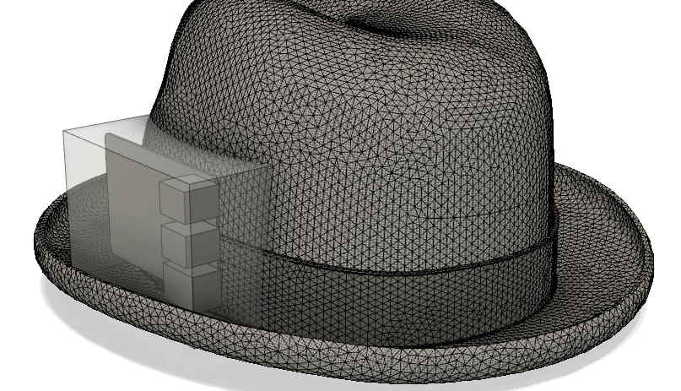
IOT Hat Design

Slide 70
BACKGROUND
Identify Hair Disease using IOT HAT.
Shows the Real time Hair condition
IT20129026 | Alahakoon D.Y.R | TMP-23-154

Slide 71
RESEARCH QUESTION
How machine-learning-based IOT device
Detect Hair Disease
Get High Accuracy
IT20129026 | Alahakoon D.Y.R | TMP-23-154

Slide 72
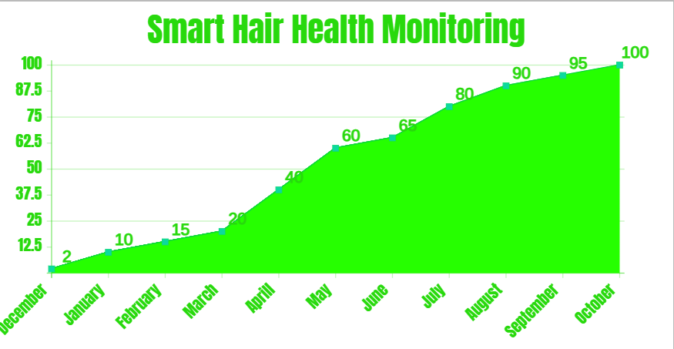
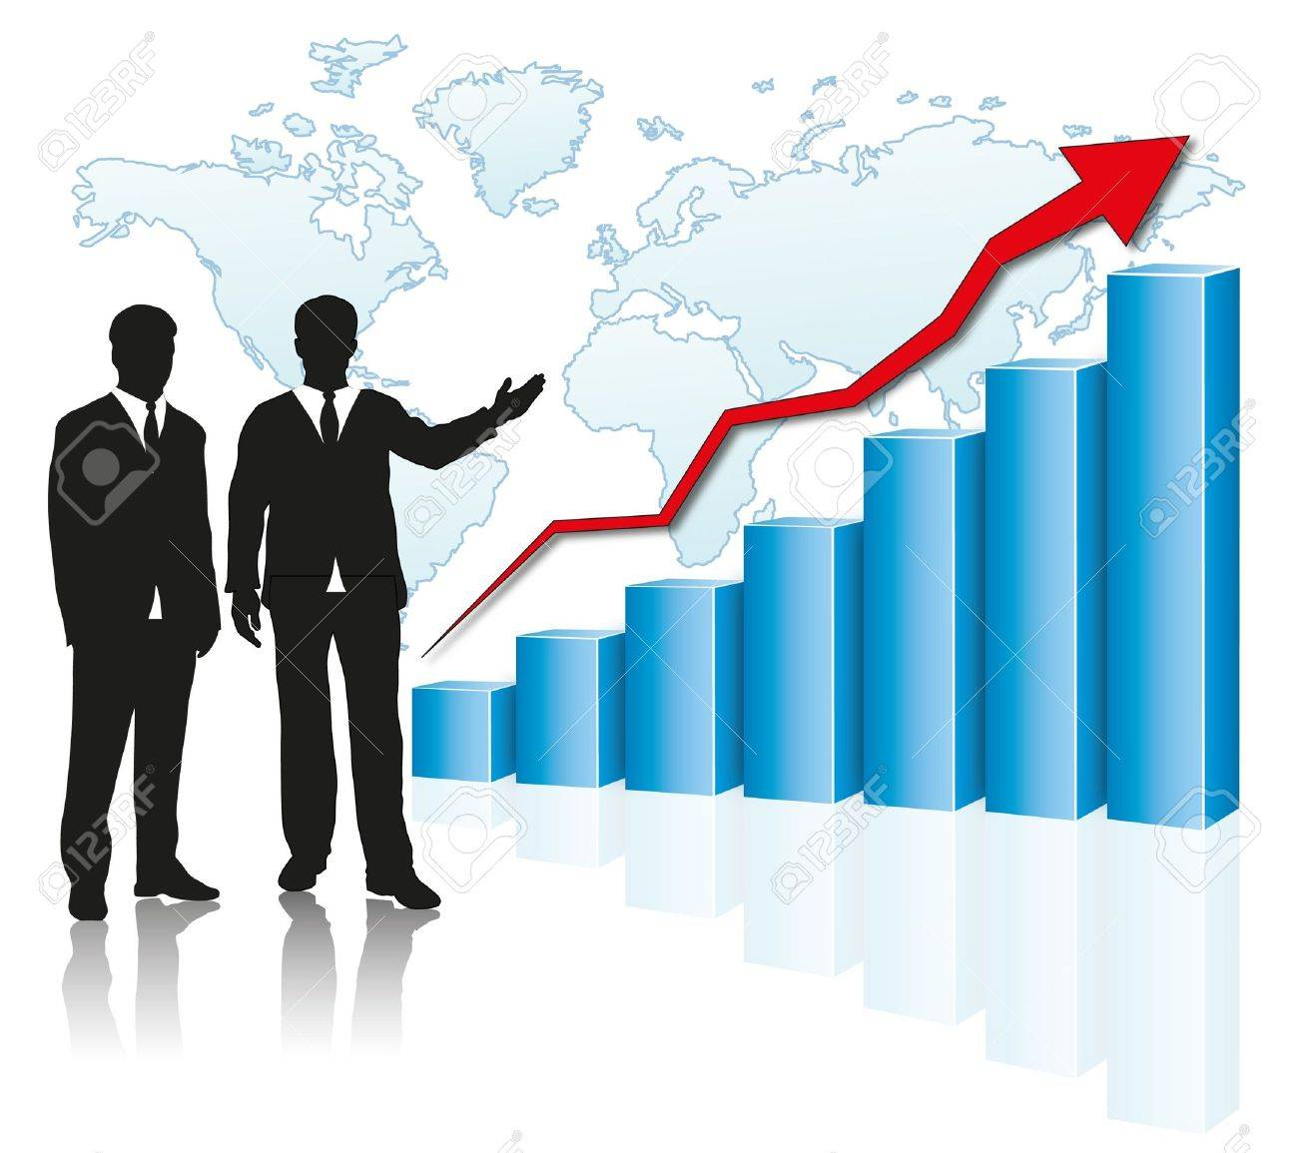
PROGRESS.
IT20129026 | Alahakoon D.Y.R | TMP-23-154

Slide 73
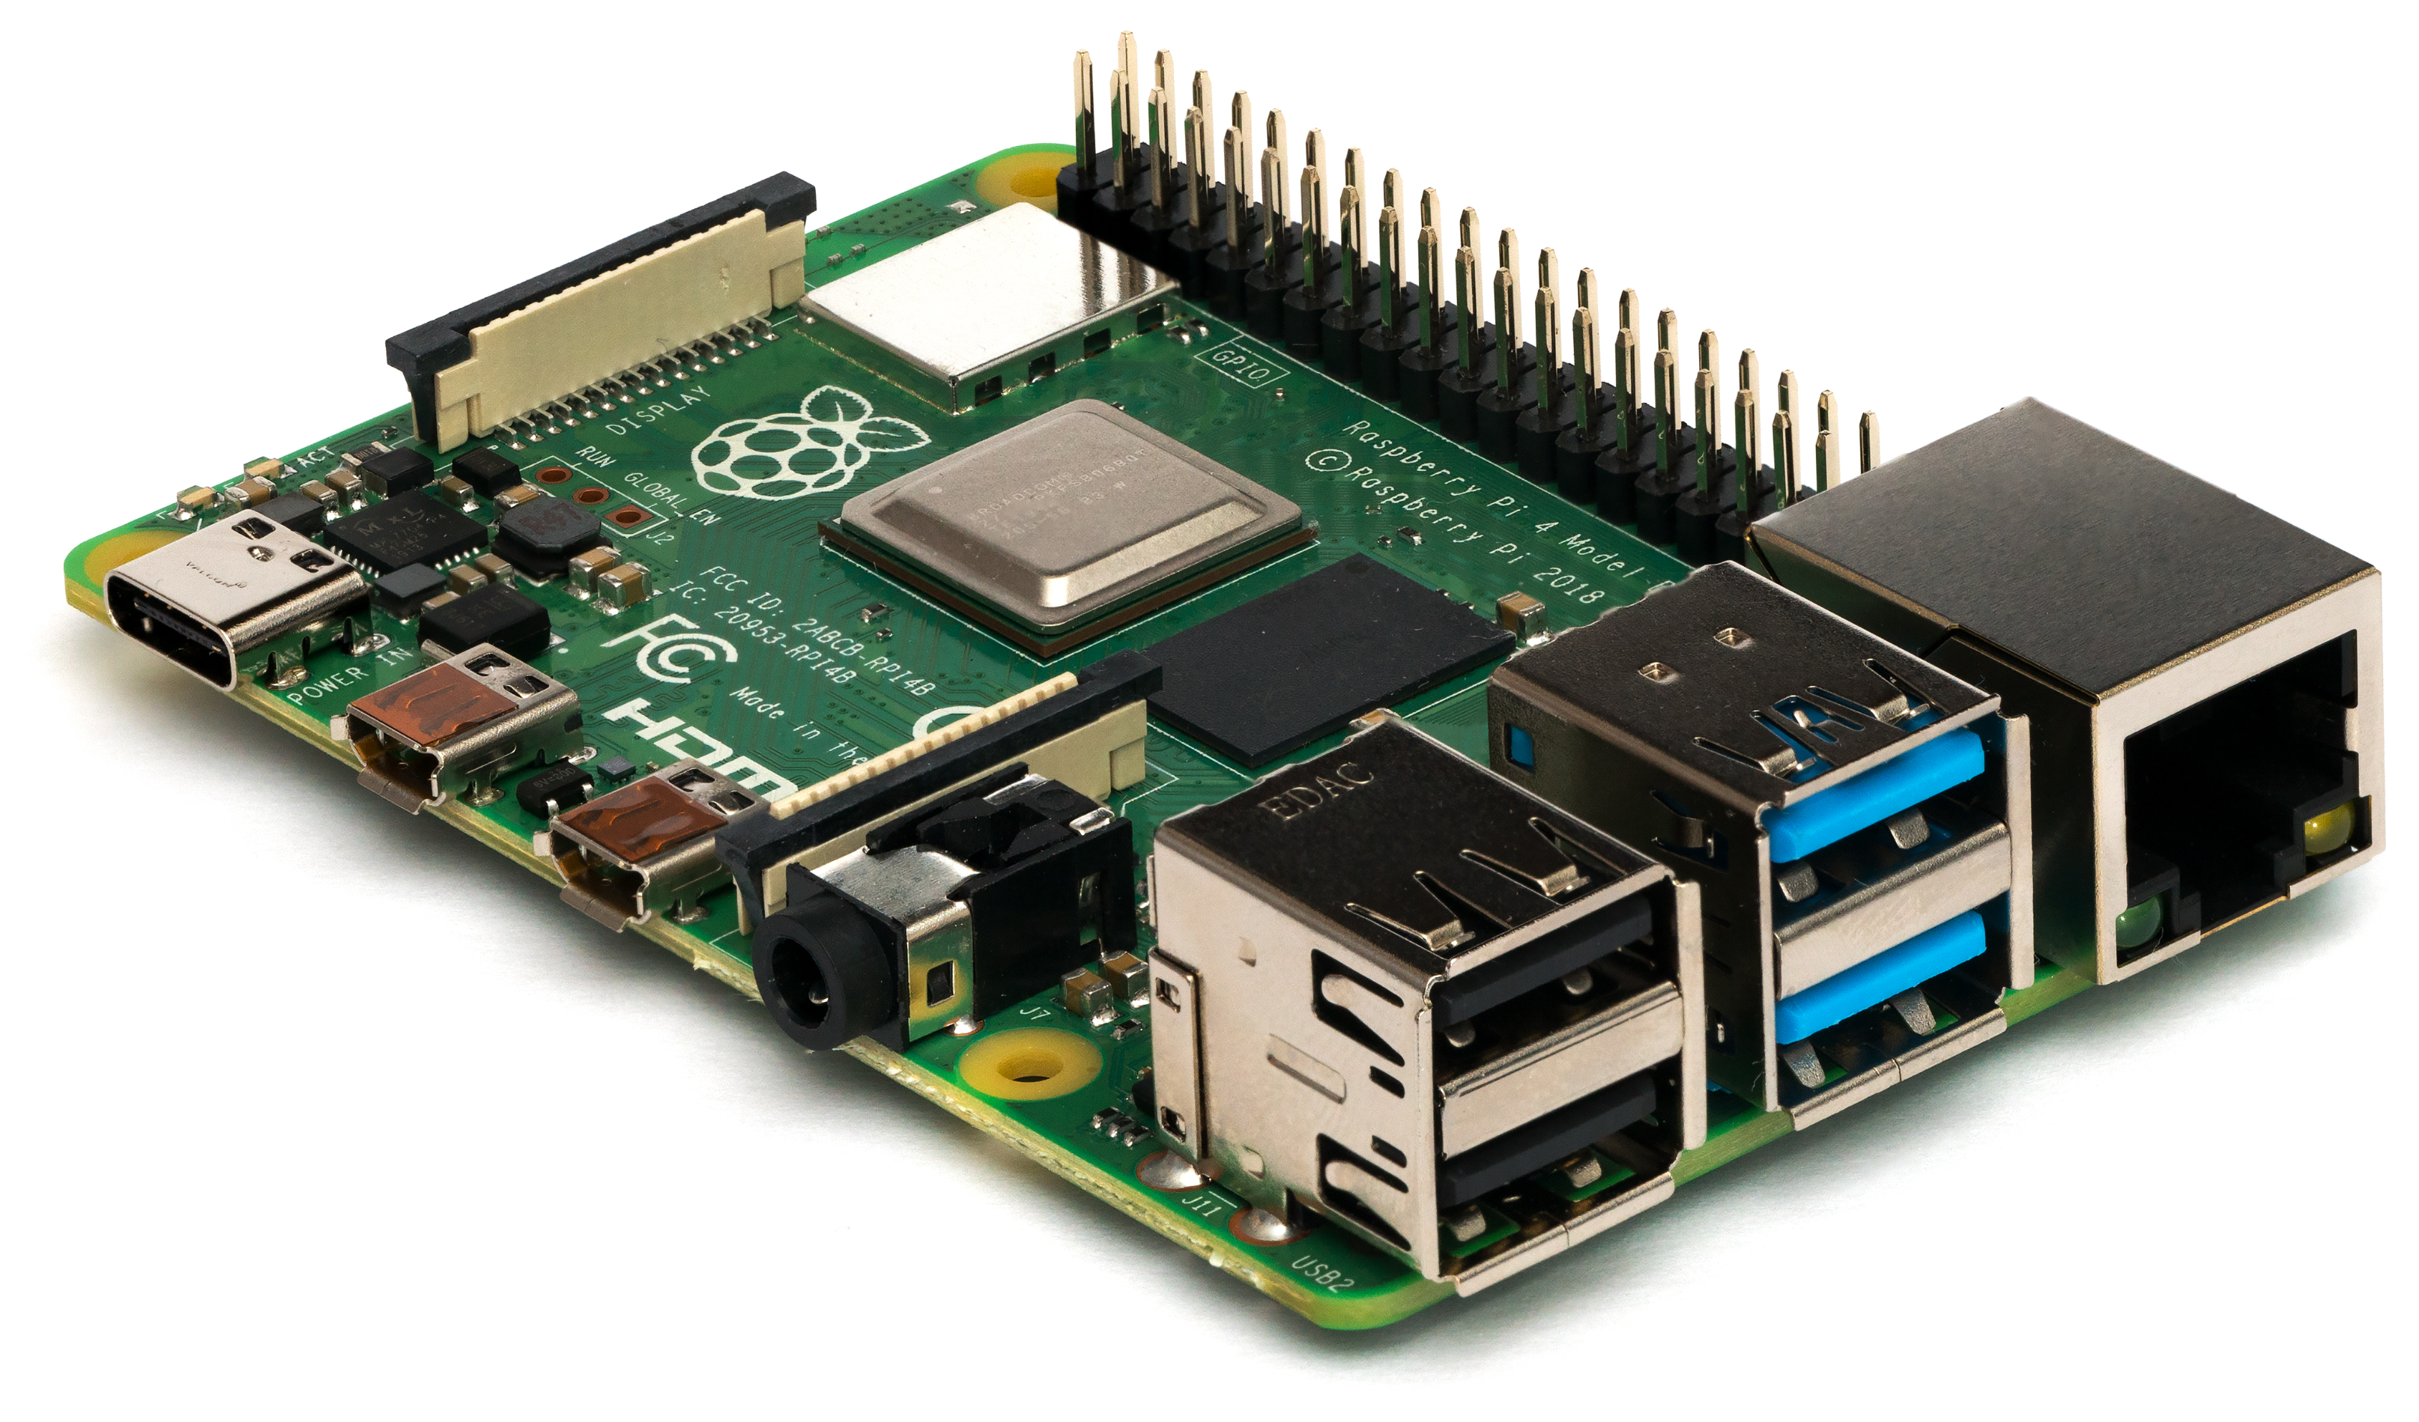
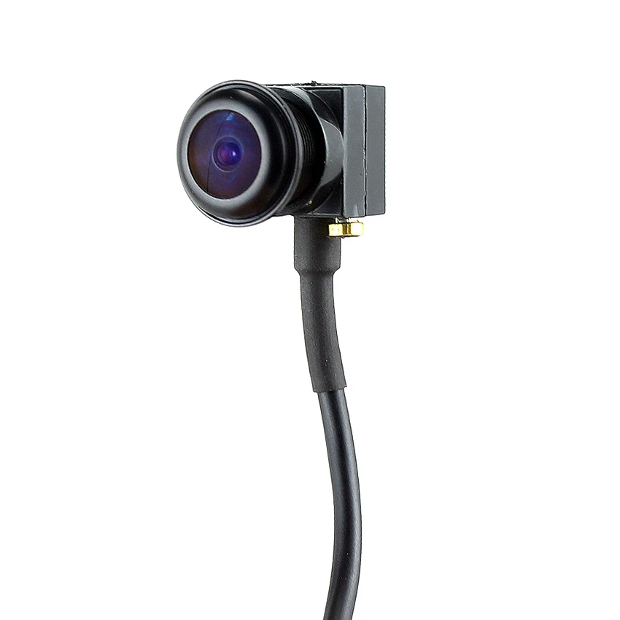
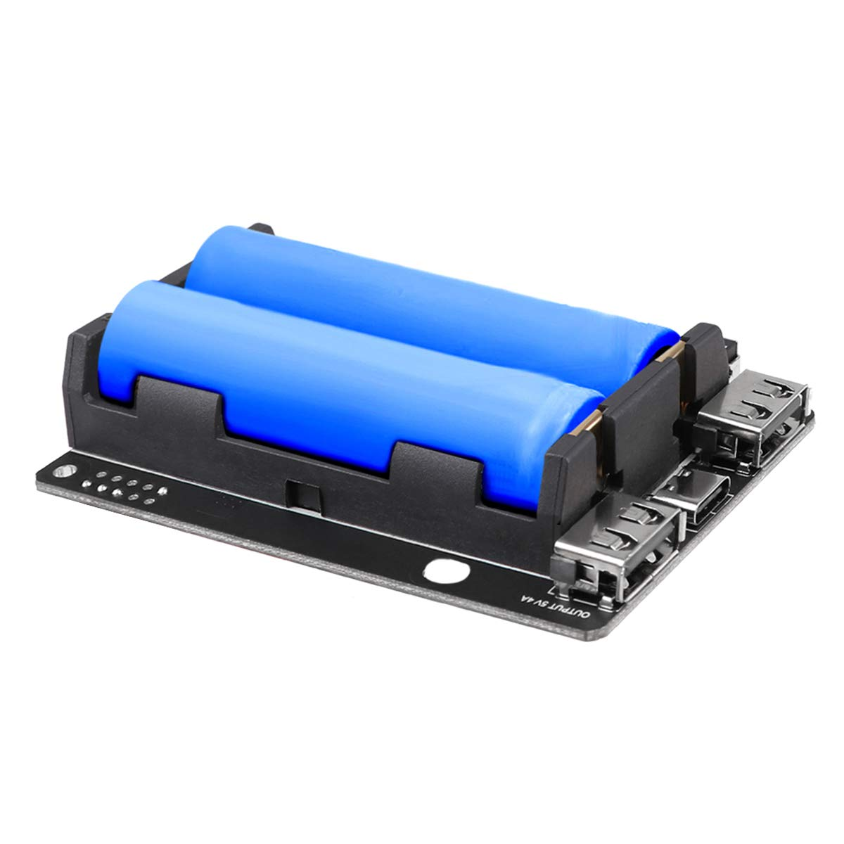

IOT DEVICE COMPONENTS.
Rasbery PI 3 Board
5MP wide angle sonny camera
LED Flasher
Power Bank
Jumper wires
MCP3008 IC
IT20129026 | Alahakoon D.Y.R | TMP-23-154

Slide 74
OBJECTIVES
Collect healthy hair images.
Detecting healthy hair to there is any disease.
Include lithium-ion battery.
Power source using power bank.
Identify hat Wear or not.
Testing and improving.
IT20129026 | Alahakoon D.Y.R | TMP-23-154

Slide 75

ACHIEVEMENTS
Training Dataset and get high accuracy
Preparing the necessary environment in the machine
Buildup IOT Device
IT20129026 | Alahakoon D.Y.R | TMP-23-154

Slide 76

SYSTEM DIAGRAM
IT20129026 | Alahakoon D.Y.R | TMP-23-154

Slide 77

DESIGN OF THE MOBILE APPLICATION
Showing Battery percentage.
Showing hair condition.
Show Last Sync Time.
Showing Hat ware or not
IT20129026 | Alahakoon D.Y.R | TMP-23-154

Slide 78


TOOLS AND TECHNOLOGIES
Mobile Application
Android Studio
Database
Firebase
Middle Ware Technologies
Python
Technical Concepts
Image Processing (IP)
Dataset
Kaggle
IT20129026 | Alahakoon D.Y.R | TMP-23-154

Slide 79
WHAT'S TO BE DONE
Improve Head identifying
Insert healthy hair images
Include battery to inside the hat
Testing and fixed bugs
IT20129026 | Alahakoon D.Y.R | TMP-23-154

Slide 80

IT20129026 | Alahakoon D.Y.R | TMP-23-154

Slide 81


